Slide 1
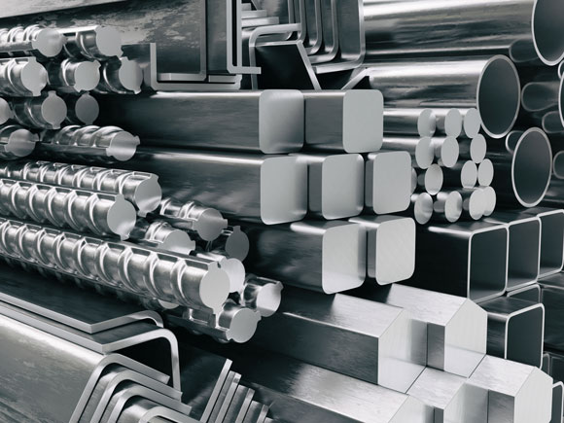
nat5 Design & Manufacture
Metal - Theory

Slide 2
Learning intentions & success criteria
Learning Intentions
Develop our understanding of metals, tools and manufacturing processes.
Success Criteria
I can name all the tools used in the metal workshop.
I can explain the different properties of metals.
I can name and explain the different manufacturing processes for metals.

Slide 3
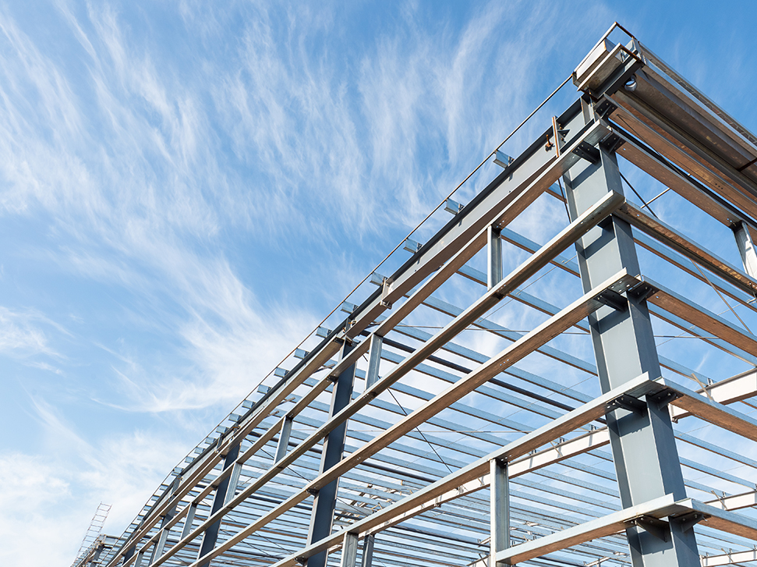
introduction
Metals have been mastered for the use in many things for thousands of years, such as:
Iron and bronze for tools and weapons
Steel for use in construction
Gold and Silver for jewellery and decoration
Plutonium and Uranium for fuel

Slide 4
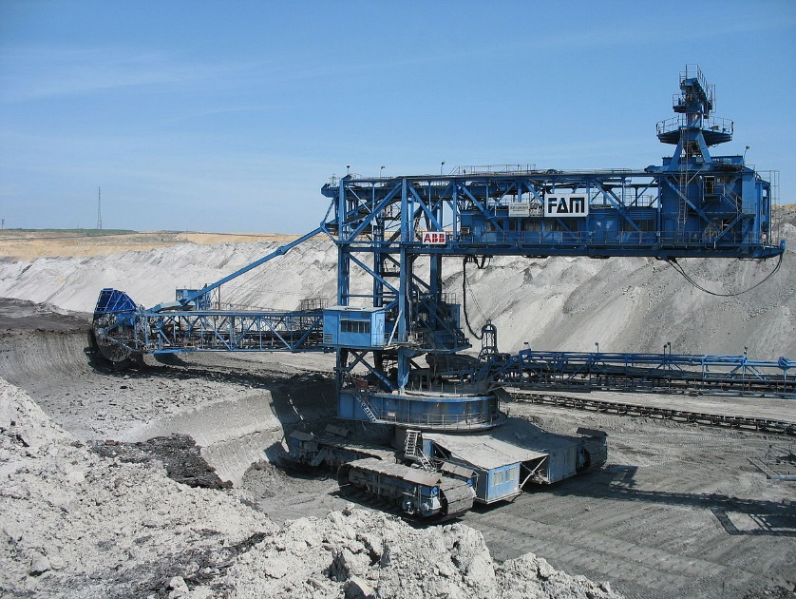
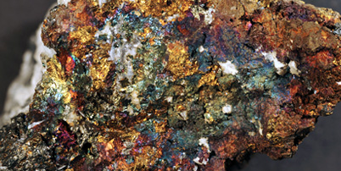
Where does metal come from?
Metals come from the ground and are extracted from their ORES.
Ores are a mixture of rock and metal.
These must be separated by a process called SMELTING, i.e. applying heat.

Slide 5
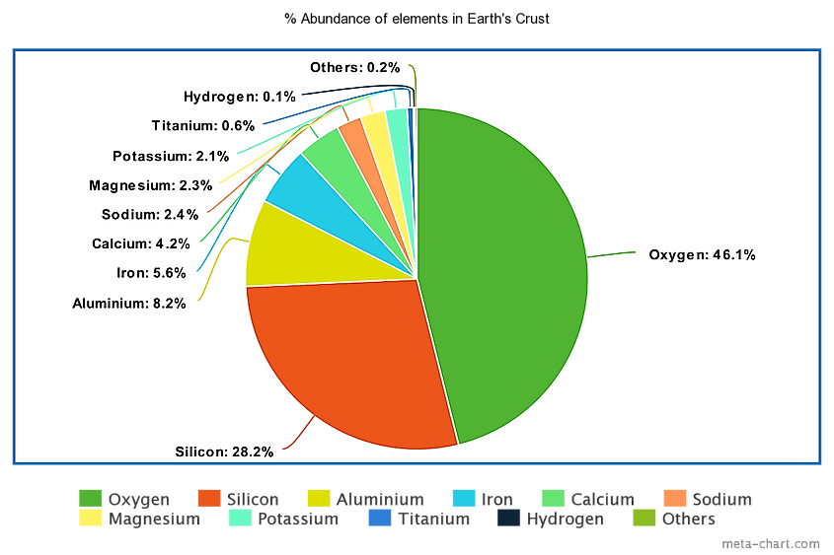

Slide 6
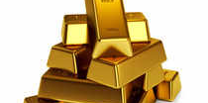
Pure metals
A pure metal is a metal that contains atoms of only one type of metallic element. There are around 95 pure metals in the periodic table.
Examples include:
Gold
Aluminium
Copper
Iron

Slide 7
alloys
An alloy is a mixture of a PURE METAL and either:
Other pure metals
A non-metal, e.g. Carbon
Examples include:
Brass (Copper and Zinc)
Duralumin (Aluminium and Copper)
Bronze (Copper and Tin)
Steel (Iron and Carbon)

Slide 8
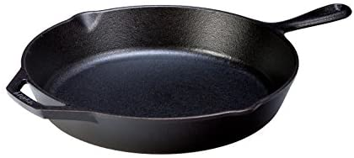
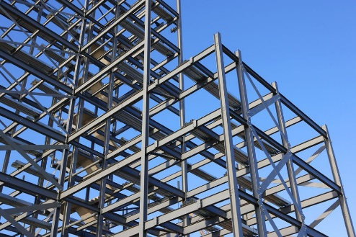
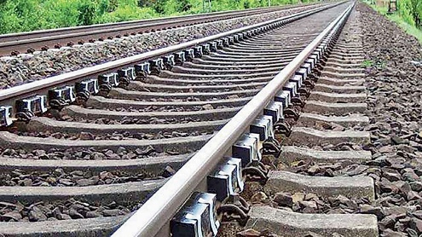
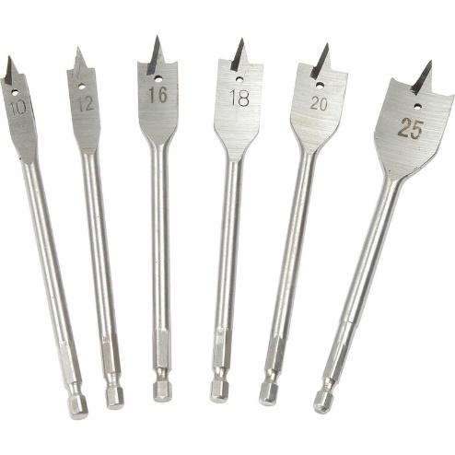
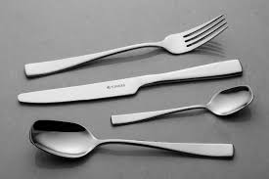
Ferrous metals
A ferrous metal is:
Metals and Alloys that contain Iron
They are usually MAGNETIC
They RUST
Examples include:
Cast Iron (cooking pans)
Mild Steel (structural steel, signs, wire)
High Carbon Steel (railways, chisels)
High Speed Steel (cutting tools)
Stainless Steel (cutlery, cookware)

Slide 9
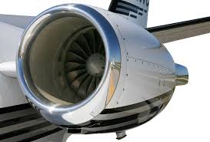
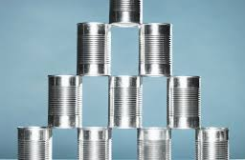
Non-Ferrous metals
A Non-ferrous metal is:
Metals and Alloys that DOES NOT contain Iron
They are usually NON-MAGNETIC
They DO NOT rust
Examples include:
Aluminium (cans, foils, aeroplane parts)
Copper (wiring, construction, plumbing, cladding)
Tin (cans, solder for circuit boards)

Slide 10
Properties of metals
To understand why we use particular metals for particular products or jobs, we must understand their properties.
There are a number of properties you must remember to be able to describe your answers in detail in tests, exams and in your assignments.

Slide 11
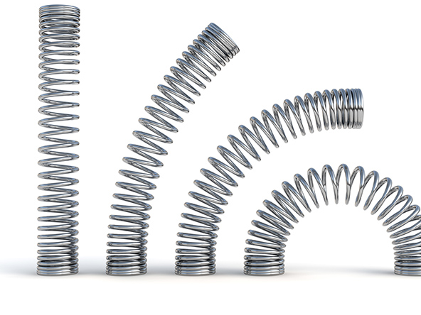
elasticity
The ability to return to shape after deformation.
e.g. a spring, car suspension.

Slide 12
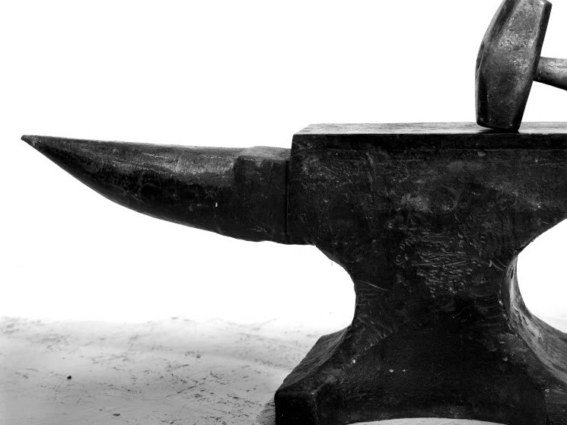
toughness
The ability to withstand sudden loading (from impact resistance).
e.g. an anvil resisting the impact of being hit by a hammer.

Slide 13
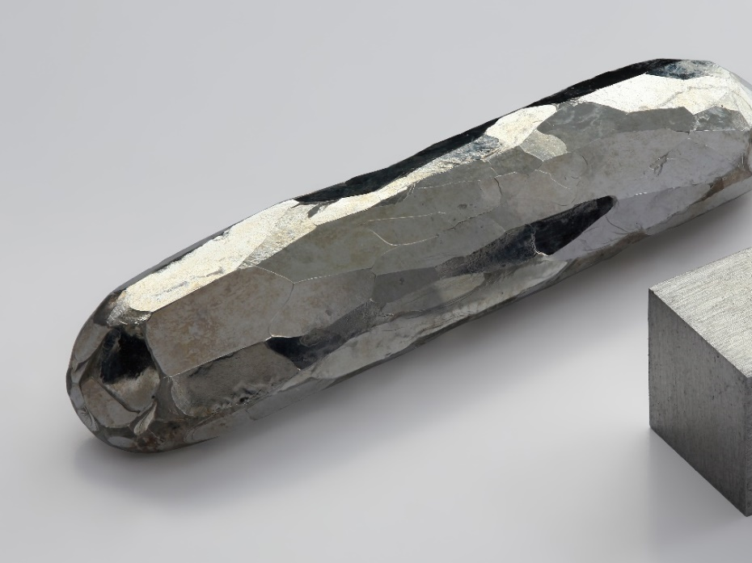
hardness
Resistance to wear or indentation.
If two metals are rubbed together, the harder metal will scratch the softer one.
A scriber is made from a harder metal than the metal it is inscribing on: if this was the other way around, the scriber would blunt easily.

Slide 14
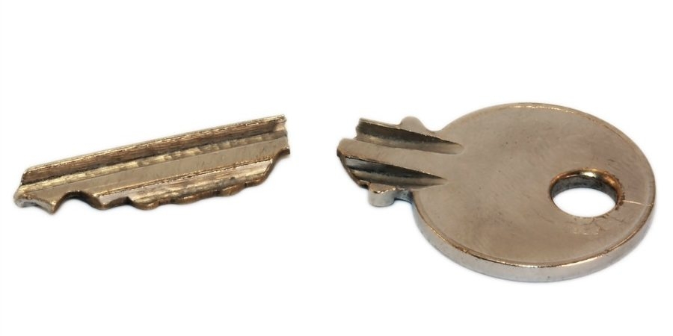
brittleness
The ability to be snapped easily.
The brittleness of metal is affected by cooler temperatures, therefore a key is more likely to snap if it is cold.

Slide 15
Malleability
The ability to be hammered into shape without cracking or fracturing.

Slide 16
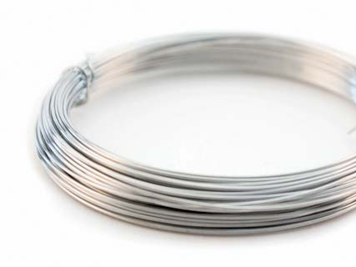
ductility
The ability to be stretched (drawn) and to a reduced cross-section (thinner).
Metals can be drawn out to form wires for example.

Slide 17
Ferrous metal properties
Name | Composition | Properties | Uses
Cast Iron | Iron + 3.5% Carbon | Smooth, soft core, strong when compressed, cant be bent or forged. | Vices, lathe beds, garden bench ends and car brake drums.
Mild Steel | Iron + 0.15 - 0.35% Carbon | Ductile, malleable, tough, high tensile strength, corrodes easily. Easily welded. | Car bodies, machine bodies, nuts and bolts, screws, nails and girders.
High Carbon Steel (tool steel). | Iron + 0.8 - 1.5% Carbon | Very hard, rather brittle, difficult to cut, poor resistance to corrosion. | Tool blades e.g. Saws, chisels, screwdrivers, centre punches and so on.
High Speed Steel | Iron + Tungsten, chromium vanadium. | Very hard, heat resistant, remains hard when red. | Drills, lathe cutting tools, milling cutters, power hacksaw blades and so on.
Stainless steel | Iron + chromium, nickel, magnesium. | Tough, hard, corrosion resistant, wears well, difficult to cut, bend and file. | Cutlery, sinks, teapots, kitchen ware, saucepans and so on.

Slide 18
Non- Ferrous metal properties
Name | Composition | Properties | Uses
Aluminium | Pure Metal | Strong, light, malleable, ductile, difficult to weld, non-toxic, resists corrosion, conducts electricity and heat well and polishes well. | Kitchen foil, drinks cans and saucepans.
Duralumin | Alloy = Aluminium + Manganese, magnesium. | Stronger than pure aluminium and nearly as strong as mild steel but only one third the weight. | Greenhouses, window frames and aircraft bodies.
Copper | Pure Metal | Tough, ductile, malleable, conducts heat and electricity well, corrosion resistant, solder and polishes well. | Electrical wire, central heating pipes, circuit boards, saucepan bases.

Slide 19
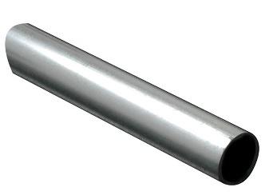
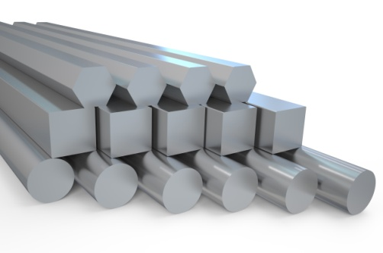
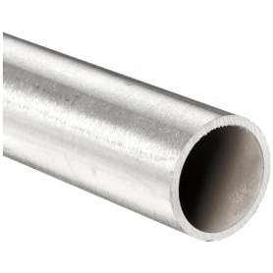
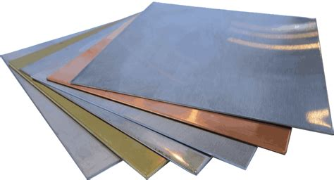
Forms of metal
1.
2.
Rod
Bar (available in a range of cross-sections, e.g. square, triangular, hexagonal etc.).
Flat Strip
Tube
Angle
Sheet (<3mm thick)
Plate (≥3mm thick)
Various other channel sections
3.
4.
5.
6.
7.

Slide 20
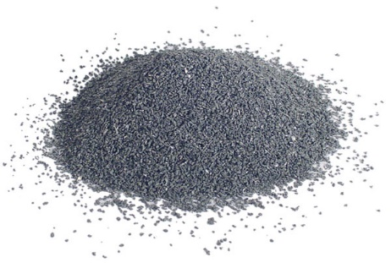
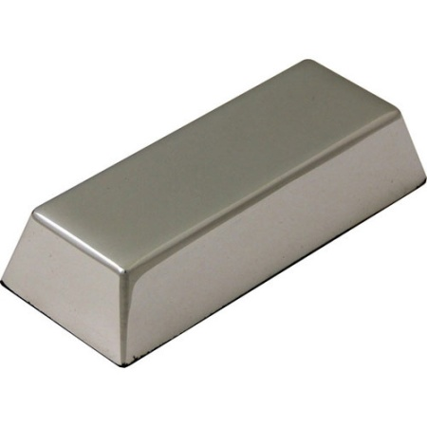
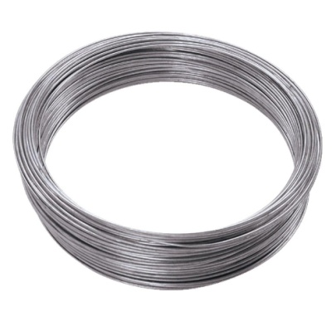
Forms of metals
Metal can be supplied in various forms:
Powder (fine metal powder can be used for 3D printing).
Ingots (large blocks of metal which are melted down to use for moulding metals).
Wire (available in a range of thicknesses and lengths).

Slide 21
Metals and the environment
Mining and processing metallic ores into useful products has a huge environmental impact.
They all differ in their impact, but generally:
Require energy to be extracted
Produce harmful pollution
Destructive effect on the landscape
Can be absorbed by humans (e.g. if leaked into water systems)

Slide 22
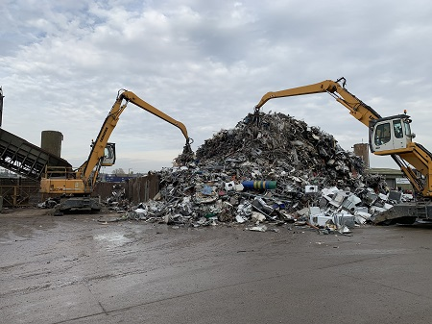
Recycling metals
Recycling metals has become very important for the environment
The value of scrap metal has become increasingly more valuable
Recycling metal requires (in most cases), less energy than mining, processing and manufacturing new metals.

Slide 23
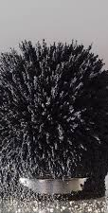
Know your metals
IRON: second most common metallic element on Earth. Pure iron is very soft. Rusts with exposure to air and water. Is the most common to make alloys.
NICKEL: often alloyed with other metals, including steel to manufacture guitar strings, batteries and coins. It is resistant to corrosion therefore is often used to simulate decorative silver.
TIN: one of the earliest used metals, used with copper to make bronze. Non-toxic, therefore is often used for food cans.
ALUMINIUM: most common metal on Earth, found in the Bauxite ore. Takes a large amount of energy to extract. It is light weight and has a low melting point.

Slide 24
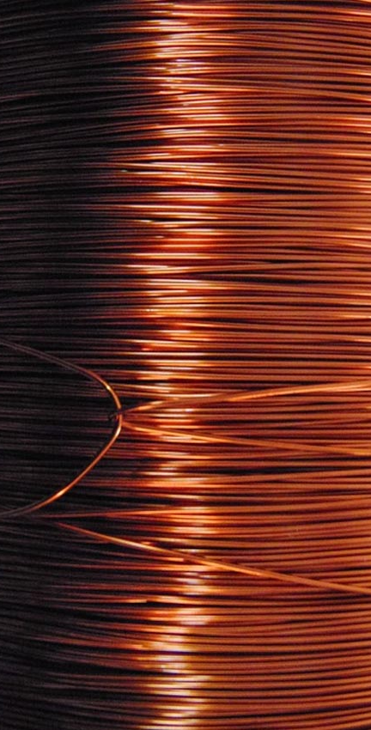
Know your metals
Steel: alloy of iron and carbon. The amount of carbon added with determine the strength and malleability of steel.
COPPER: most commonly used in electrical wires and pipes as it is very malleable and ductile. Copper alloys kill bacteria and are used for sterile surfaces.
BRASS: alloy of zinc and copper, most commonly used to manufacture a range of objects from cooking pots to door knobs. It is malleable and corrosion resistant.
PEWTER: alloy of tin, bismuth, antimony and copper. It has a very low melting point and is very malleable. It has been used for thousands of years to create decorative items like tableware and plates.

Slide 25
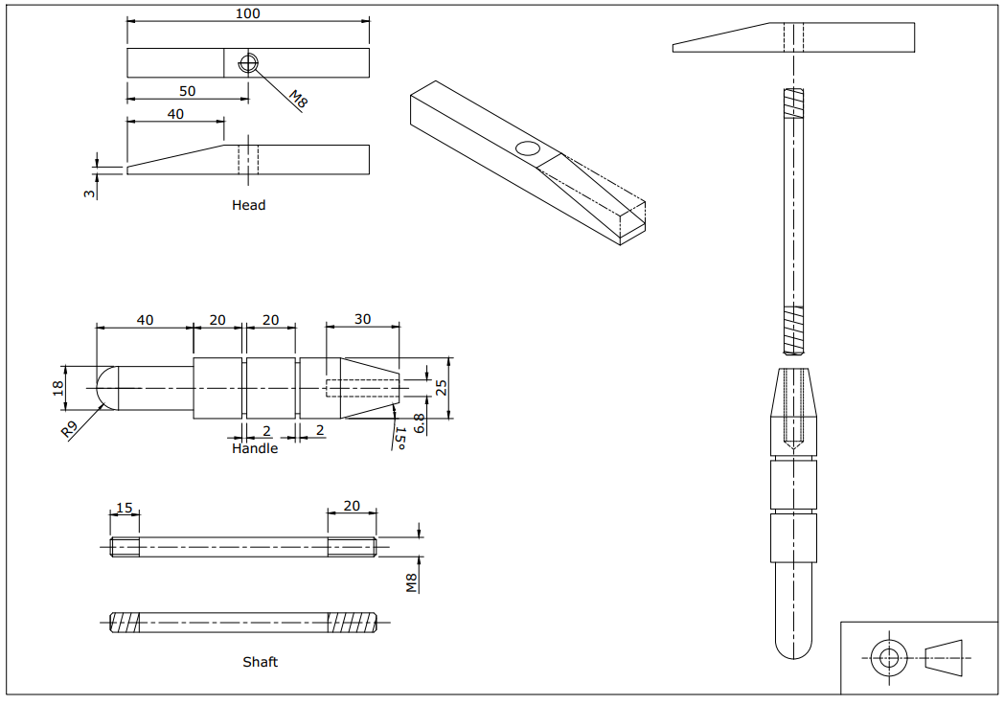
Metal practical assignment Toffee hammer
Toffee hammer practical task

